Slide 1
AdwentureWorks sales
Presentation

Slide 2
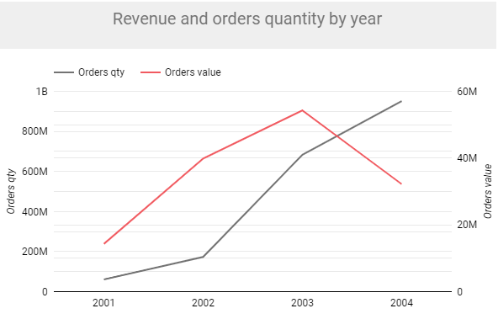




The growth of revenue was almost twice
compare average of month revenue in 2001 (2,387,925.37$)
to average of month revenue in 2004 (4,599,558.92$).

Slide 3
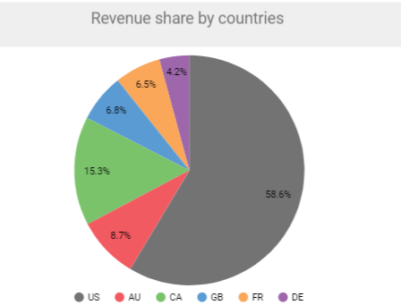
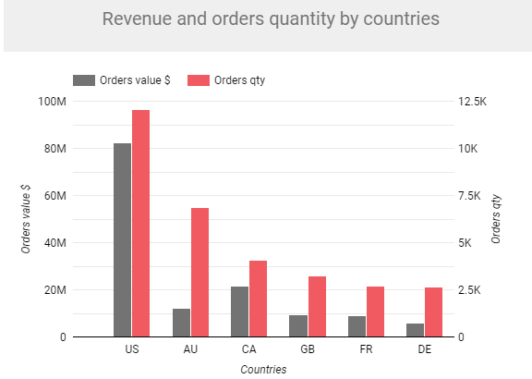
The biggest part of revenue and orders came from US clients.

Slide 4
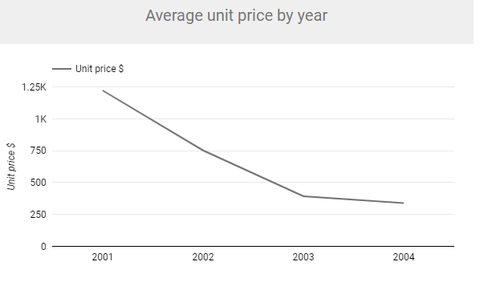
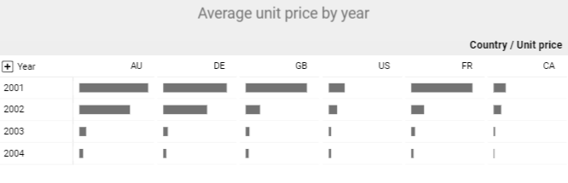
The average of unit price
in July of 2003 (281.58$ ) is ~49% lower
compare to the same period in 2002 (559.05$)
and ~80% lower compare to July of 2001 (1,413.97$).

Slide 5
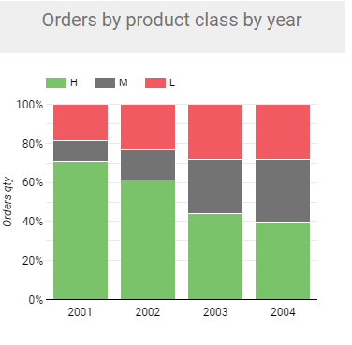
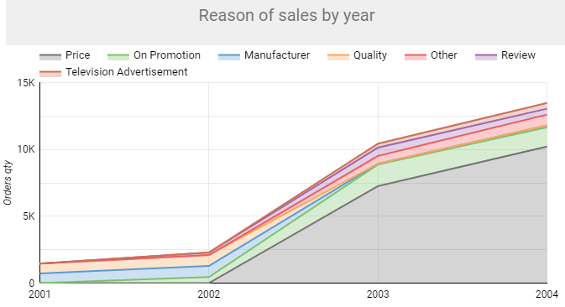
Average unit price changes determined clients habits changes.
The sales of low class goods increase
from 18.79% in 2001 till 39,61% in 2004 year.
*
* H – high, M- medium, L-low
From 2002 the price was the main reason of sales.

Slide 6
Recomendations
Try to keep the same growing of customers activity without price level loses.
To check and evaluate assortment of expensive products. If it is need to add new products in high demand.
To use sales reason research data for targeted marketing campaign.

